Slide 1
Welcome to Data Structures & Algorithms
Or, how to pass technical interviews given by programmers
Terence Parr
MSDS program University of San Francisco

Slide 2
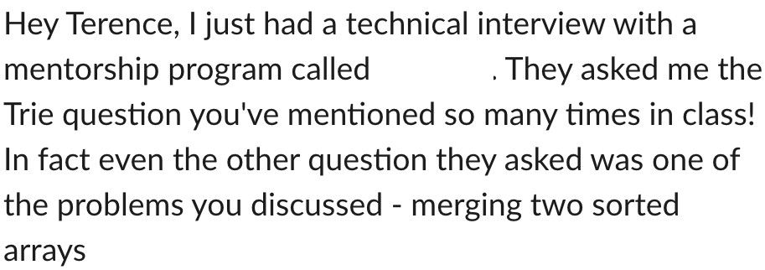
From former cohort student

Slide 3
Course contents
https://github.com/parrt/msds689
How to read code
A formula for problem-solving simple algorithm problems
Core data structures, a unifying perspective
Algorithm complexity analysis
“So much recursion!” – MSDS2019 student comment
Walking and searching data structures
Sorting (with all of my dirty tricks)
Graphs and graph algorithms

Slide 4
Course projects
Convert htable project to object-oriented version (8%)
With some extensions
…and using somebody else’s code from two years ago!
hint: it’s kinda stinky code. ha!
kmeans clustering, kmeans++ initial point selection (17%)
Spectral clustering using Breiman’s unsupervised learning trick for RFs
Image compression applications
Feature importance and selection (20%)
Permutation and drop column
Automatic feature selection
Work as hard or as little as you want (I give no unit tests)
I will assign check, check-, check-- based upon your reports
https://github.com/parrt/msds689/blob/master/projects/oohtable/oohtable.md
https://github.com/parrt/msds689/blob/master/projects/kmeans/kmeans.md
https://github.com/parrt/msds689/blob/master/projects/featimp/featimp.md

Slide 5
Student evaluation
Please note grading will take at least a week
For projects, but I’ll grade exams quickly
last day of class

Slide 6
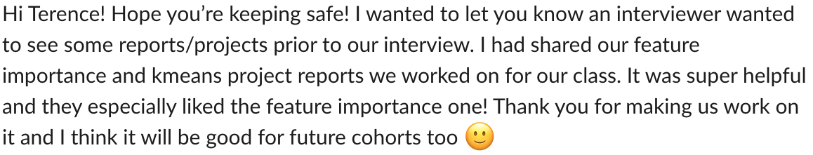

Kmeans and feature importance projects
Practice writing and implementing algorithms

Slide 7
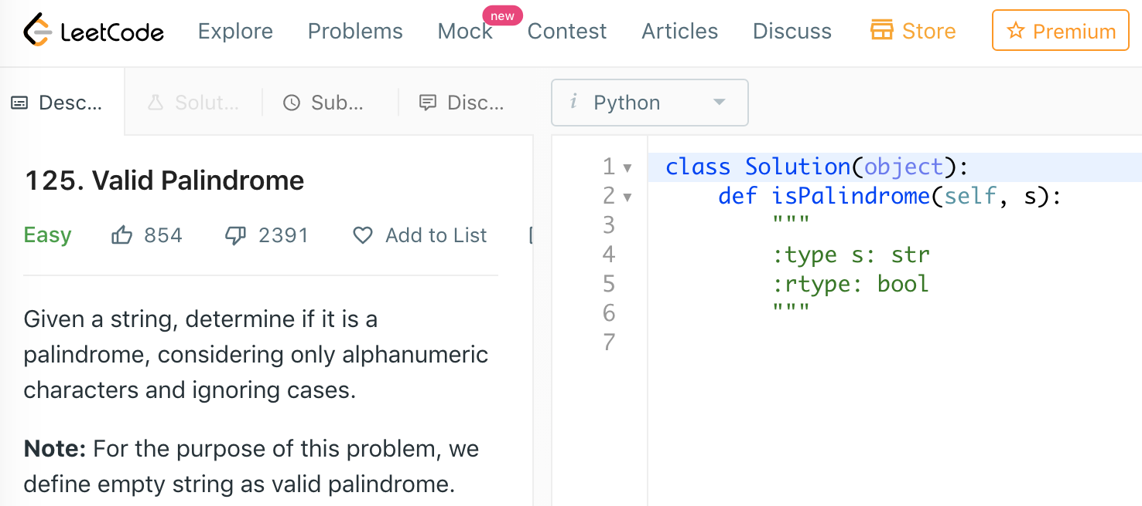
Extra things you can do
Lots of little practice quizzes; e.g., https://github.com/parrt/msds689/blob/master/labs/quiz-oo.ipynb
LeetCode algorithm and data structures challenges. e.g., https://leetcode.com/problems/valid-palindrome/

Slide 8
Resources
A great free book on algorithms by Jeff Erickson
Kleinberg and Tardos, Algorithm Design
Please see compressed pdf kleinberg-common-running-times.7z in Canvas course files area (do not post material publicly please)
A very useful set of programming-concepts-for-data-science and data science coding questions by former USF MSDS student Shikhar Gupta
10 steps to solving a programming problem
Review OO notebook and Operator overloading notebook

Slide 9
Administrivia
The usual academic honesty rules will be enforced; in projects, reports, exams or any other artifact; Honor Code
Do not represent another person’s work as your own
Don’t leave your laptop unattended/unlocked; others can take a picture of your code or simply use a USB key quickly
Students with Disabilities
If you are a student with a disability or disabling condition, or if you think you may have a disability, please contact USF Student Disability Services (SDS) for information about accommodations.
If you are sick, please let us know beforehand, not after-the-fact
More details on the course syllabus: https://github.com/parrt/msds689

Slide 10
Why this course, why now?
At least for the moment, many of the people interviewing you will be programmers, pretending to be data scientists
What do they know? Programming, data structures, and algorithms
Being able to organize data within a machine or across machines is a key skill for a data scientist
The larger the data, the more critical it is to understand how to measure algorithm performance and how to design efficient solutions
Optimally, you'd get this course much earlier, but the timing is good for your interviewing and was only spot we could jam this course in

Slide 11
How to get a job
Be accomplished, be interesting
Know lots of people
Mine social network looking for job
When that fails or simultaneously
Cold apply to jobs via the web (a lot!)

